Slide 1
PYTHON PROGRAMMING

Slide 2
Why Python
Extremely easy to learn.. Powerful, free, high level language, interpreted, large community
Portable and extensible -- can integrate .Net, Java, C++ programs.. Web development provides array of frameworks (Django, flasks, web2py etc).. Scrape websites.
AI and ML -- Libraries like scikit learn, keras, tensorflow.. With AI, we make machine mimic the human brain.. analyse, and make decisions based on it. Libraries like opencv used for image recognition -- computer vision -- can detect face, colour, character, handwriting etc

Slide 3
Why Python
Computer graphics and game development -- libraries..
Testing frameworks -- tools and frameworks available
Big data -- handles Big Data. libraries available like pyspark etc
Scripting - Automation -- scripting so we can automate certain tasks..
Data science -- we heard matlab.. for scientific research. Python has numpy and pandas. deals with tabular, matrix, statistical data. Also visualise using matplotlib and seaborn
Popular and high salary -- US avg sal $116000. Many companies google, FB, dropbox, youtube, etc

Slide 4
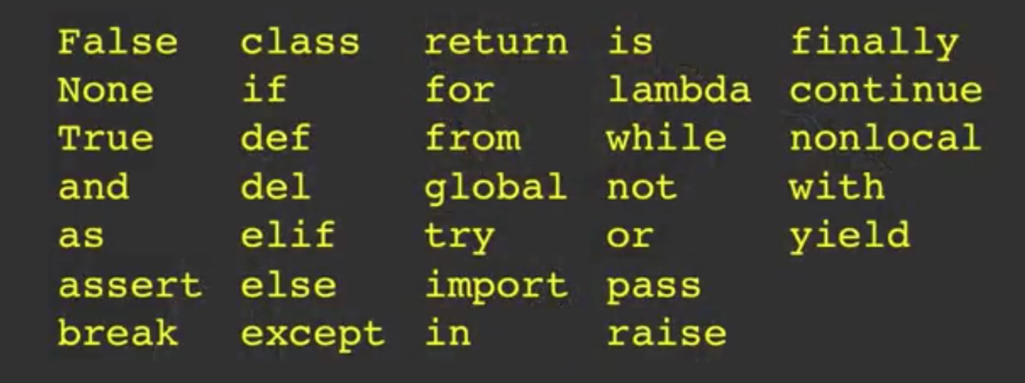
Keywords
Keywords
Numeric Expressions
X = 2 → Variable. A container which holds some value
X = X + 3
Y = 440 * 12

Slide 5
Datatypes
We do not need to declare data types of variables in Python. It works based on variables original assignment.
Mutable – list, dict, set
Immutable – string, number, tuple
Important data types – booleans, numbers (int, float), strings, bytes, lists, tuples, sets, dicts, None.
Since everything is an object in python so there are types like module, function, class, method, file, etc.
Boolean – True, False. E.g. >>> size < 0. True is 1 and False is 0.
>>> True + False

Slide 6
Datatypes
Numbers – Python supports both integers and floating point numbers. There is no type declaration to distinguish them.
>>> type(size) >>> isinstance()
Built-in Data types
Number (int, float, complex)
String
Tuple
List
Dict
Set
Boolean
None
Custom Data Types (An Object)

Slide 7
Documentation
It is format to define the documentation of a program.
A special variable __doc__ is used to print the documention of a function, class or program.
def approximate_size(size, a_kb_is_1024=True):
'''Convert a file size to human-readable form.
Keyword arguments:
size -- file size in bytes
a_kb_is_1024 -- if True(default), use multiples of 1024
if False, use multiples of 1000
Returns: string
''’
It is valid only if written before the first executable command

Slide 8
Core Objects
Numbers
Strings
List
Tuple
Dictionary
Set
Files
None
Boolean

Slide 9
Datatypes
>>> 11 / 2
>>> 11 // 2
>>> -11 // 2
>>> 11.0 // 2
>>> 11 ** 2
>>> 11 % 2
/ → performs floating point division.
Lists – much more than array in java. Holds arbitrary objects and can expand dynamically as new items are added
A_list = [1,4, ‘abc’, 2.5, ‘a’ ]
Negative index accesses items from the end of the list counting backwards
Slicing a list – a_list[1:3], a_list[:3], a_list[3:], a_list[:]
A_list.append(True), a_list + [0,1,2,3], a_list.extend([4,5]). Value in a_list, a_list.count(4)
del – by index, remove() – by value.

Slide 10
Datatypes
Tuples – A tuple is an immutable list. A tuple can not be changed in any way once it is created.
Cant add/remove elements to tuple. Tuples have no append() or extend() method.
Tuples are faster than lists. If you’re defining a constant set of values and all you’re ever going to do with it is iterate through it, use a tuple instead of a list.
Lists cant be used as dict keys but tuples can be. Since it is write protected.
Sets – A set is an unordered “bag” of unique values. A single set can contain values of any datatype. can find union, intersection on set
a_set = {1} or a_set = {1, 2}, a_set = set(a_list)
Empty set a_set = set(). A_set.add(1)

Slide 11
Datatypes
a_set = {1, 2, 3}
a_set.update({2, 4, 6})
>>> a_set
{1, 2, 3, 4, 6}
Dicts – unordered set of key-value pairs.
None – special constant in Python (null value). None is not the same as False. None is not 0. None is not an empty string. Comparing None to anything other than None will always return False.
Type(None), None == False,

Slide 12
Operators
Arithmatic Operators → +, -, *, /, **, %, //
Comparison Operators → ==, !=, >, <, >=, <=
Condition operators → and, or
Boolean Operators → True, False
Assignment Operators → =, +=, *=, -= …
Binary Operators → <<, >>, &, |, ^
Identity Operators → is, is not
Membership Operators → in, not in

Slide 13
Precedence
**
~ + - * / % //
>> <<
&
^ |
<= < > >=
== !=
%= /= //= -= += *= **=
Is, is not
In, not in
And, or, not

Slide 14

Relational operators
Relational operators: ==, !=, <, >, <=, >=
Equal objects are interchangeable
==
True
>>> A = 20
>>> A == 30

Slide 15
Conditional Statements
if Expression:
print('It is True')
if h > 50:
print(“Greater than 50”)
else:
if h < 20:
print(“Less than 20”)
else:
print(“Between 20 and 50”)
Python provides elif keyword to eliminate the need for nested if … else structures in many cases.
Flat is better than nested

Slide 16
For Loops
Repeats a set of statements over a group of values
for var in group_of_values:
print(‘Loop while Expression is True’)
The range specifies a range of integers
range(n)
range(n, m, s)
for x in range(10):
print(x)
for x in range(5, 0, -1):
print(x)

Slide 17
While Loops
while loop: Executes a group of statements as long as a condition is True.
good for indefinite loops (repeat an unknown number of times)
while Expression:
print(‘Loop while Expression is True’)
count = 5
while count:
print(count)
count -= 1

Slide 18
break, continue, pass
break keyword terminates the innermost loop, transferring execution to the first statement after the loop
Continue – jump to the next iteration skipping all statements after continue keyword
Pass – do nothing. It’s a filler

Slide 19
Strings
Immutable sequence of unicode characters
>>> “first” ”second”
Multiline Strings
Windows – carriage return + new line → \r\n
Linux – \n
Python doesn't need to consider.. It has universal new line \n
Escape Sequences
\n, \t, \\, \b, \r etc
When dealing with some strings like windows paths or regular expressions we use \ extensively. Pathon had option to use raw string
E.g. path = r’C:\Users\Ganesh\Documents\sample.txt’

Slide 20
Strings
We can use str constructor to create string representation of other types like int, float etc
>>> str(23)
String in python are sequence types. We can access using indices.
No character type. ‘x’ and ‘a long string’ both are strings
>>> help(str)
>>> dir(str)
Python strings are unicode. Default encoding is utf-8

Slide 21
Indexes and Slicing
Characters in a string are numbered with indexes starting at 0
>>> name = ‘Dr. Reddy’
name[0], name[1]..
String functions
Slicing
name[startIndex : EndIndex : Step]

Slide 22
String
String Functions
String formatting, Indexing,
Slicing.
name[startIndex : EndIndex : Step]

Slide 23
User Input
We can instruct python to pause and read data from user using input() function. Input() functions returns a string.
name = input(‘Enter file name: ’)
hd= open(name, ’r’)
Counts = dict()
For line in hd:
words = line.split()
for word in words:
counts[word] = counts.get(word,0) + 1
Inp = input(‘Floor Num: ‘)
Actual_floor = int(Inp) + 1

Slide 24
Import
Import search path
Import xyz – copy the module. From xyz import fun – copy fun
Use standard boiler plate in every python program. It is mandatory in case of multithreading or multiprocessing
if __name__ == '__main__':

Slide 25
List
Much more than arrays in C. Holds arbitrary data
lst = [‘a’, 2, 5, 6.3, True]
Can be indexed and slices
lst[0], lst[1], ..
lst[start : End : Step]
Just like strings, second number is “up to but not including”
Lists can be manipulated
a[2] = a[2] + 22
a[0:2] = [9,8]
len(a)

Slide 26
List
Lists can be sliced using :
lst[start : End : Step]
Just like strings, second number is “up to but not including”
Index the entries based on position

Slide 27
Dict
Dictionary is a built-in object which holds key-value pair (item). Dictionary holds items in random order like hash mapping — Unordered collection
Key —> has to be immutable (and unique) —> string, number. We index the things in dict with a lookup tag
values —> can be anything
Dict is mutable and dynamic in nature. No order
D = dict(name='Bob', age=40) -- alternate construction
D = dict([('name', 'Bob'), ('age', 40)])
D = dict(zip(keyslist, valueslist))
del d —> delete dict del d[‘a’] —> delete an item

Slide 28
Tuple
Comma separated values in a bracket
Immutable – so more efficient. Once created, cant alter its contents.
Simple and more efficient in terms of memory use and performance than lists. If we want temp variables, prefer tuple over list
Arbitrary items in tuple
Mydict.items() → returns list of (key, value) tuples.

Slide 29
Set
Collection of unique elements – unordered collections of items. Mutable. Cant be indexed.
No duplicates
>>> my_set = {2,3,5,7,8,2,3}
Union – set1 | set2 --- combined all elements but will have common
Intersection – set & set2 --- non common elements
Difference – set1 – set2

Slide 30
Comprehensions
More readable and faster than standard loops (faster since it works as generators)
List comprehension – a compact way of mapping a list into another list by applying a function to each of the elements of the list.
Dict comprehension – it constructs a dictionary instead of a list
{value:key for key, value in a_dict.items()}
Set comprehension – sets just have values instead of key:value pairs
{x ** 2 for x in a_set}
No tuple comprehension

Slide 31
Functions
Set of instructions used to perform a single and related actions.
Function provides better modularity to a program and a high degree of freedom to reuse existing code
Non-keyword argument should not follow keyword argument
Cannot have non-default argument after default argument
By default function returns None. Some rules to be followed when
Built-in functions
Object functions
UDF
Module functions

Slide 32
Functions
Passing immutable objects (like string, number, tuple) acts like call-by-value. (they cant be modified by function)
def make_me_rich(balance):
balance = 1000000
account_balance = 500
make_me_rich(account_balance)
Print(account_balance) → prints 500
Passing mutable objects (like dict, list) acts as call by reference. (they gets modified by function)

Slide 33
Functions
Passing mutable objects (like dict, list) acts as call by reference. (they gets modified by function)
def talk_to_advisor(tasks):
tasks.insert(0, "Publish")
tasks.insert(1, "Publish")
todos = ["Graduate", "Get a job", "Profit!"]
talk_to_advisor(todos)
print(todos) → can see modified list

Slide 34
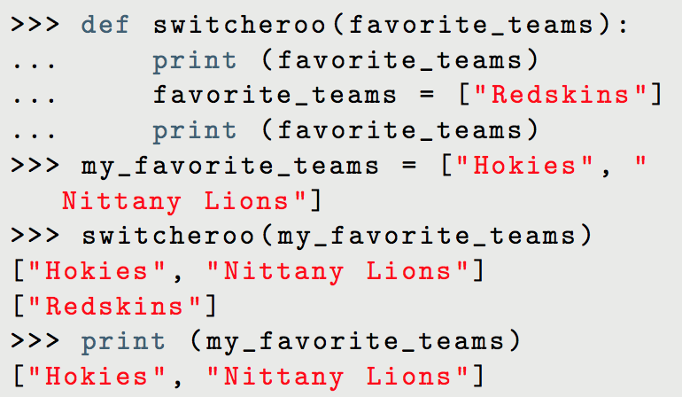
Functions
However, you cannot assign a new object to the argument
A new memory location is created for this list
This becomes a local variable

Slide 35
Multiple Return Values
def powers(number):
return number**2, number**3
squared, cubed = powers(3)

Slide 36
Lambda Functions
Small, anonymous functions
Can be passed as arguments where you need a function (like a call back function)
lambda (parameters) : expression

Slide 37
Errors
Syntax Errors
Runtime Errors – Needs to be handled to avoid abrupt stops of the program. Handled using try/except
Logical Error – Use debuggers. Import pdb can be used in program. Pdb.set_trace() OR we can use debugger provided with IDEs.
Logical error E.g.
a = 1000000000
If a == 100000000:

Slide 38
Try/Except
Try and except is a primary exception catch blocks in python which are useful to handle the runtime exceptions.
One try can have multiple except. Try/except can be nested
One try should have at least one except or finally block
Try/except block can also have else block. It is called if no exception
Finally is called always whether exception occurred or not. It is a clean up block. Else and finally can be used together. If sys.exit() is called, in that case also, it will go in finally block

Slide 39
Working with files and dirs
os.path contains functions for manipulating filenames and directory names.
E.g.
os.getcwd(), os.mkdir(), os.curdir() etc
os.system(“ls”)
file_like_obj = os.popen(‘ls’)
for root,dirs,files in os.walk(‘/file/location/’):

Slide 40
Reading Files
a_file = open('examples/demo.txt', encoding='utf-8') # use forward slash even on windows. Path can be network mounted.
- a_file.encoding, a_file.mode
Python converts that sequence of bytes into a seq of characters according to specific character encoding algorithm and return seq of unicode or string.
a_file.read()

Slide 41
Reading Files
with open('ex/demo.txt', encoding='utf-8') as fh:
fh.seek(17)
a_char= fh.read(1)
print(a_char)
When the with block ends, Python calls a_file.close() automatically
with open('test.log',mode='w',encoding='utf-8') as fh:
fh.write('test succeeded')
with open('test.log',mode='a',encoding='utf-8') as fh:
fh.write('and again')
img = open('ex/dog.jpg', mode='rb')

Slide 42
Modules and Packages
Built-in modules
User Defined Modules
Repo Modules
Once imported, .pyc file gets created. → this pyc can be provided in prod..
Whenever we import a module, python checks if .pyc exists, if not it gets created. If exists, it will check if .py timestamp > .pyc and reload into .pyc. Else ignore.

Slide 43
Regular Expressions
For generic search
Used for data filtration, data cleaning and data transformation
Regex is used for the complex searches..
E.g. extracting the IP address from a web log, getting the
timestamps from log files, email validations, phone number
validations, etc.
Mostly regex operates on string.. Identify the pattern first.
Some characters are special metacharacters..
^ . $ * + ? { } [ ] \ | ( )

Slide 44
Regular Expressions
. (a period) matches any single character except newline.
[ ] → used to specify the character class. Other metacharacters are not active inside this.
Backslash (\) – used to escape all the metacharacters so you can still match them in patterns
* used for repeating things. Previous character can be matched zero or more times. E.g. ca*t match 0 or more ‘a’. ct, cat, caat, caaaat etc
+ means one or more times. E.g. ca+t will match 'cat' (1 'a'), 'caaat' (3 'a's), but won’t match 'ct'
* matches zero or more times. so whatever’s being repeated may not be present at all, while + requires at least one occurrence.

Slide 45
Regular Expressions
{ } → {m,n}. There must be at least m repetitions, and at most n.
{x} - Repeat exactly x number of times.
{x,} - Repeat at least x times or more.
{x, y} - Repeat at least x times but no more than y times.
e.g. a{6} will match exactly six 'a'
E.g. For example, a/{1,3}b will match 'a/b', 'a//b', and 'a///b'. It won’t match 'ab', which has no slashes, or 'a////b', which has four
\w → matches any single digit, letter or underscore.
\t → matches tab. \n → matches new line
\d → matches decimal digit 0-9

Slide 46
RE Module
re.match() – checks for a match only at the beginning of the string
re.search() – scan and checks for a match anywhere in the string. Searches for first occurrence of pattern
re.findall() – Finds all the possible matches in the entire sequence and returns them as a list of strings
re.sub() – substitute function. Search and replace
re.compile() – Compiles a regular expression pattern into a regular expression object. Efficient when u want to reuse a pattern.
match checks for a match only at the beginning of the string, while search checks for a match anywhere in the string

